Slide 1
Healthkeeper Medication Timer and Tracker
Week 2 Presentation
Abbas Dargahi, Isaac Hodge

Slide 2
Introduction
HealthKeeper
A program for medication tracking and reminders
Designed for those who take prescriptions and need help keeping track of them
Current Progress
Considerable progress on the front end design of the website
Creation and beginnings of backend engine

Slide 3
Frontend
We are using HTML, CSS, and some javascript implementation on the front-end.
As of now we have four pages total which include a home page, current medications page, manage medications, and a page for help.
Upon further development we will implement a sign in/sign out feature utilizing Google accounts.

Slide 4

Backend
Using WAMP software stack for backend development
WAMP
Stands for Windows, Apache, MySQL, PHP
Software stack for web development
Allows for free software for creating the foundation of our system

Slide 5
What does WAMP do?
WAMP includes all the tools to start up a dynamic web site
Apache is a web server that allows your computer to host the website
MySQL is a database management system for the storage of data
PHP is a scripting language used to pull data from database and display it to the website
Thanks to Apache, the website is currently accessible from other devices on the LAN, not just the local computer

Slide 6
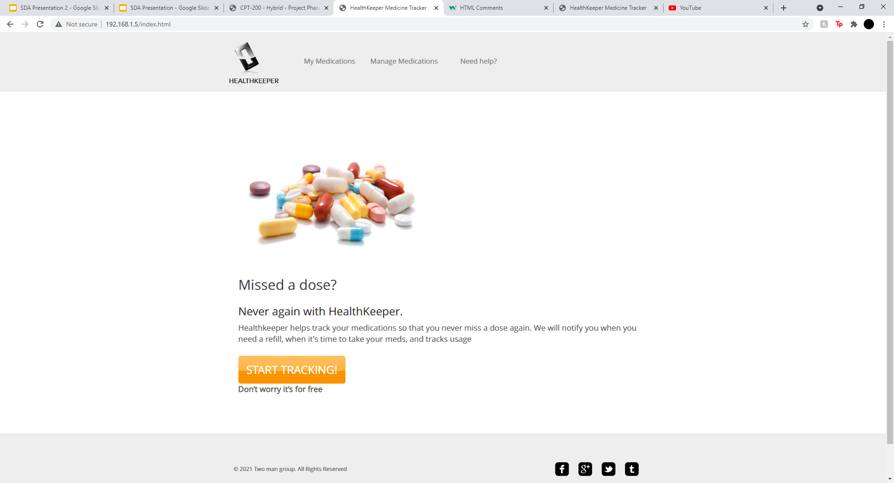
Website running off of Apache

Slide 7
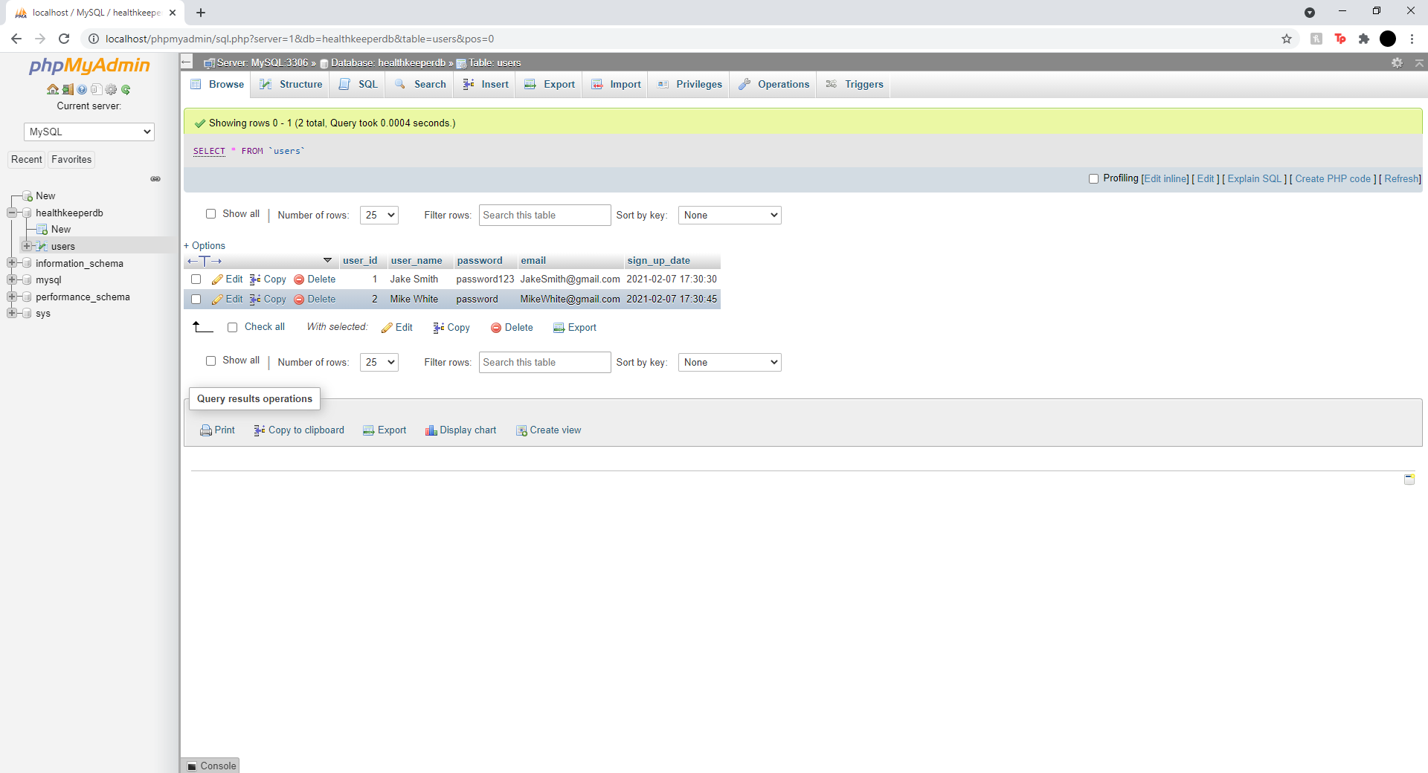
Example Database in MySQL

Slide 8
Milestone
Completed
Frontend html created and designed
Implementation of web server
Creation of database
To Do
Website access outside of LAN
Create “Manage Medications” tab
Implement database functionality
Contact message set up
Medication notification alerts

